Slide 1

Sales Data Analysis & Projection
K.Wei Shen
October 2021​

Slide 2
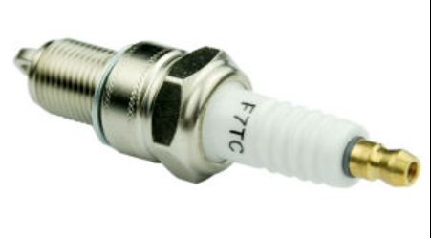

Background & Stakeholder
We are premium engine spark plug manufacturer for motorcycle, car, bus, train, ship and plane in worldwide.
The analysis & prediction aim to provide solid information for Sales & Marketing Department(Manager) in order to implement new marketing strategy and forecast sales on year 2006.

Slide 3

Overview
Problem Statement
Methodology
Inadequate sales performance insight to implement new marketing strategy.
To find out major factor which can affect and predict sales figures.
Sorting out the sales figures categorized by type of product, customer & country.
Build linear regression model to predict sales.
To classify customer by via RFM method.
Objective
To identify potential characteristic on sales trend based on historical sales data.
To predict upcoming sales based on major variables.
To identity lifetime value customer.
This Photo by Unknown Author is licensed under CC BY-NC-ND

Slide 4

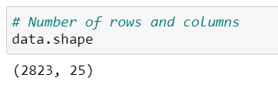
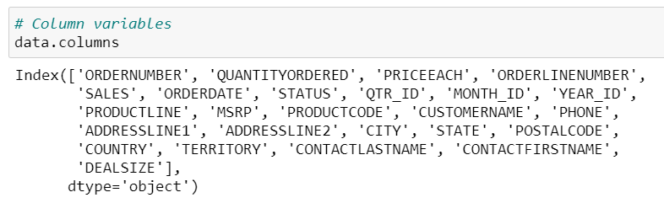
Information of Dataset
Data
Source:
https://www.kaggle.com/kyanyoga/sample-sales-data. (Year: 2003-2005)
Data Shape:
Data Features

Slide 5
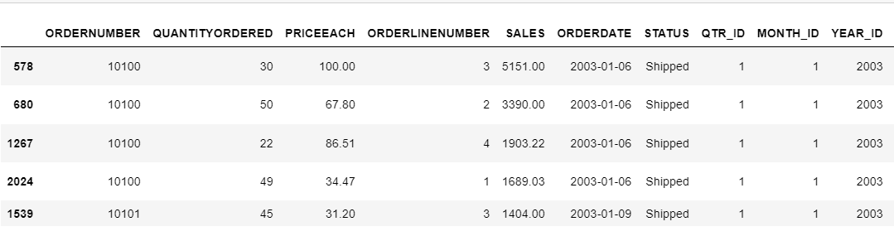
Data Frame
Data

Slide 6
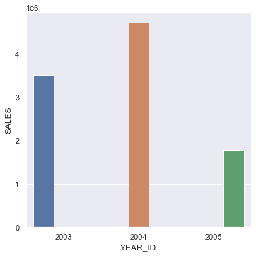
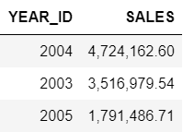
Annual Sales
EDA

Slide 7
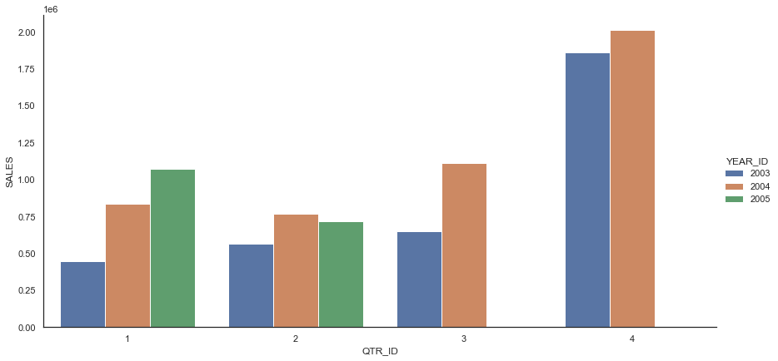
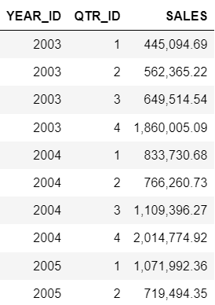
Quarterly Sales
EDA

Slide 8
Quarterly Sales
EDA

Slide 9
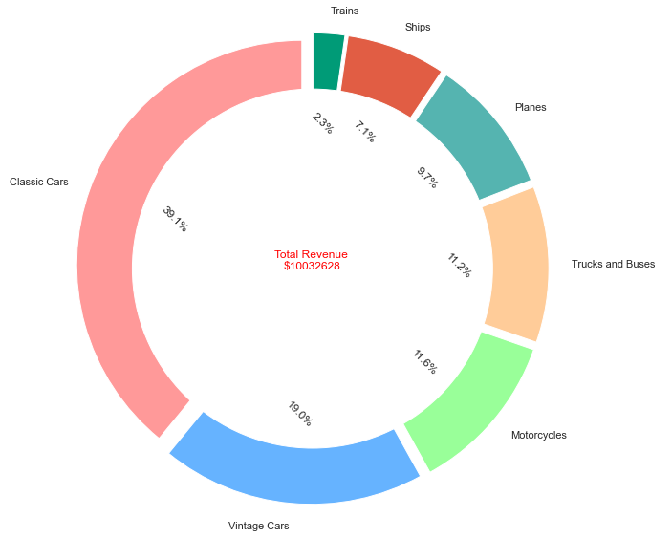
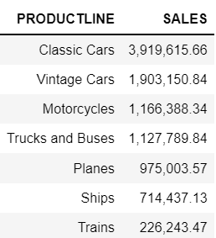
Sales Fraction By Product Line
EDA

Slide 10
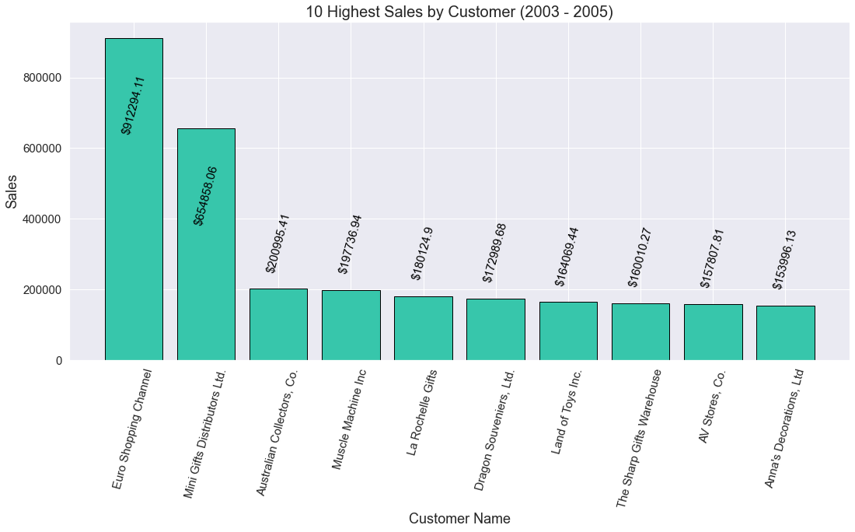
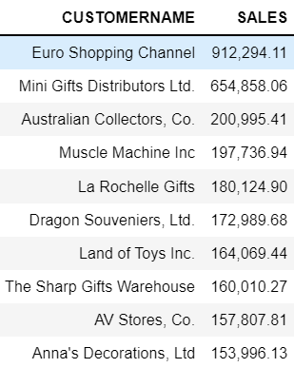
Top 10 Customer
EDA

Slide 11
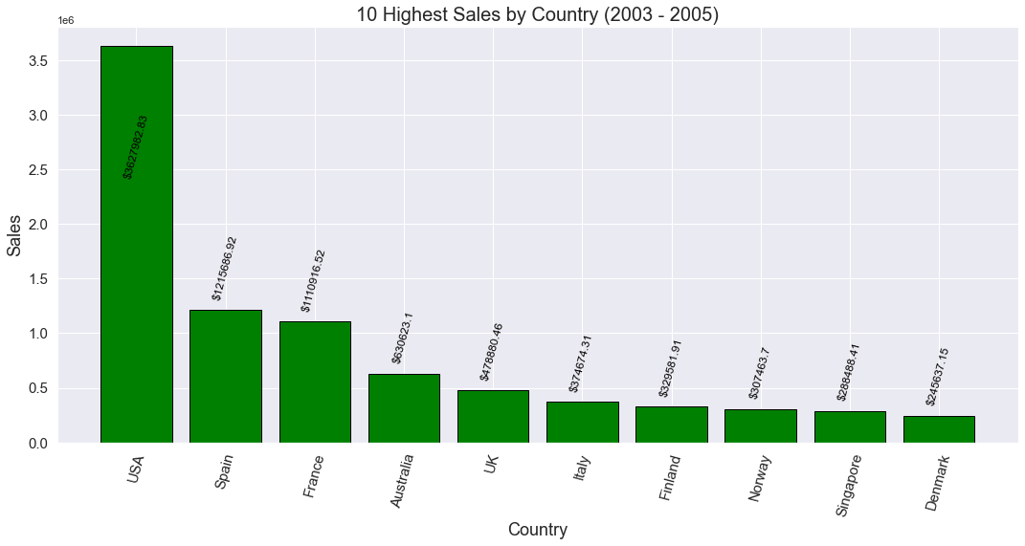
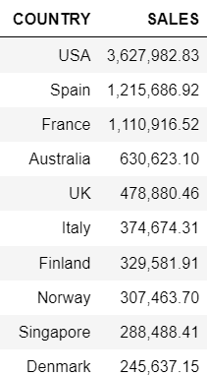
Top 10 Country
Data

Slide 12
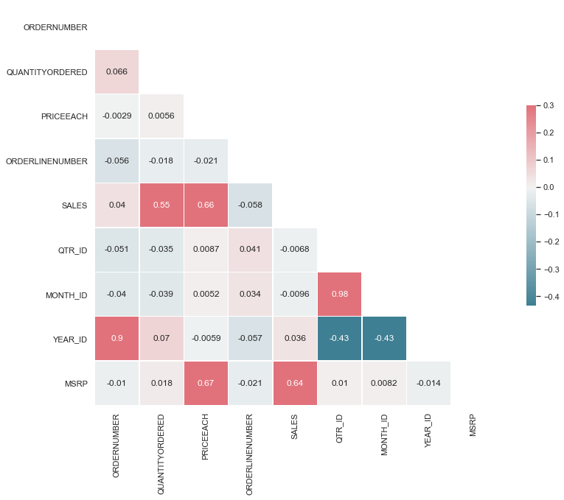
Data Correlation
EDA

Slide 13
Data Correlation
EDA

Slide 14
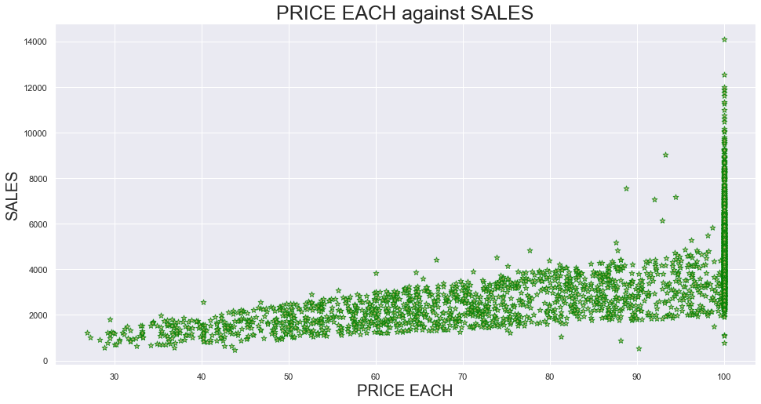
Scatter Plot
EDA

Slide 15
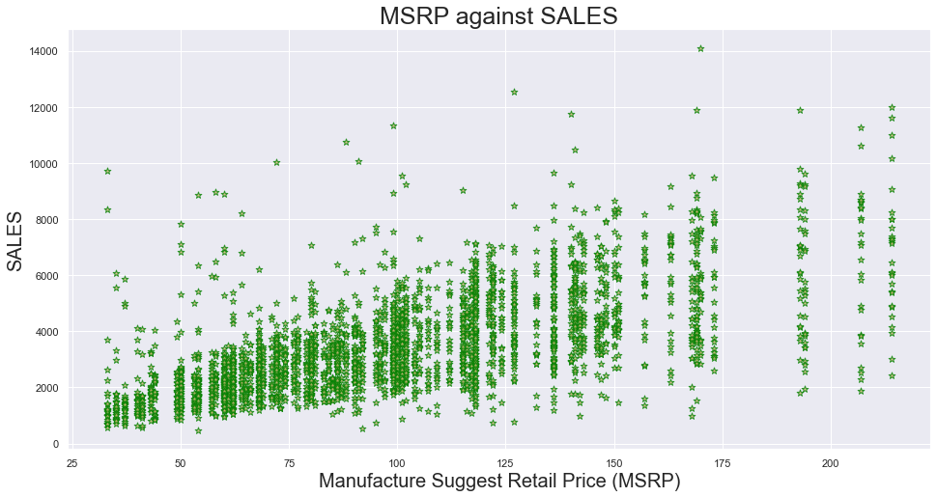
Scatter Plot
EDA

Slide 16
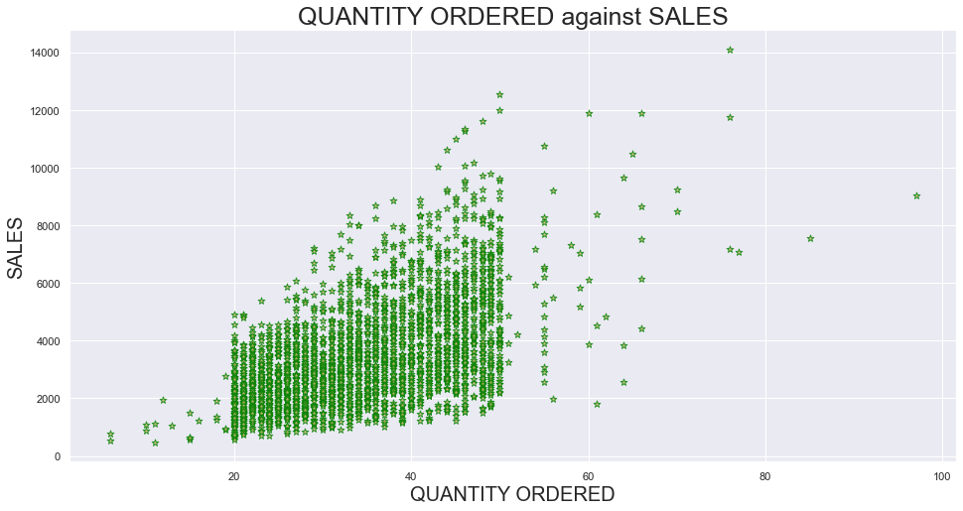
Scatter Plot
EDA

Slide 17
Linear Regression Model
Model
Features Predictor
Model
Response Outcome
Linear Regression
Input Data Set
PRICE EACH
MSRP
QUANTITY ORDERED
Prediction
SALES
Assumption
Variable with figures
Variable with high correlation to SALES

Slide 18


Linear Regression Model
Model
Data
Training Data
Testing Data

Slide 19
Linear Regression Model
Model
Data
Training Data
Testing Data

Slide 20
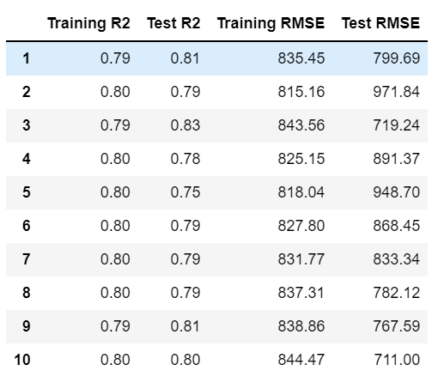

Model Evaluation
Model
Linear Regression Model

Slide 21
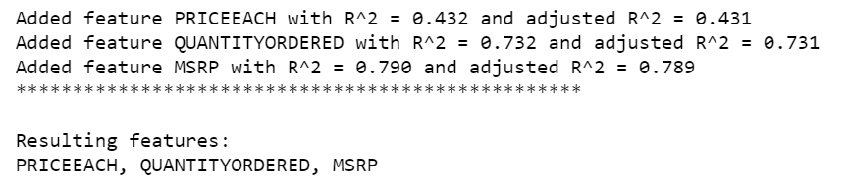
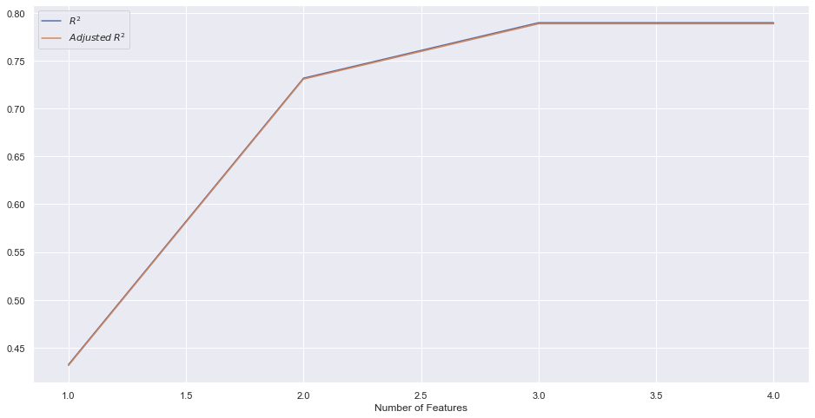
Forward Feature Selection
Model
Linear Regression Model
Forward Feature Selection

Slide 22
Prediction
Model
Features Predictor
Model
Response Outcome
Linear Regression
Input Data Set
Prediction
Assumption

Slide 23

Prediction
Model
Features Predictor
Model
Response Outcome
Linear Regression
Input Data Set
Prediction
Assumption
Mean value of the Predictor

Slide 24
Prediction
Model
Features Predictor
Model
Response Outcome
Linear Regression
Input Data Set
Prediction
Assumption
Mean value of the Predictor

Slide 25
Prediction
Model
Features Predictor
Model
Response Outcome
Linear Regression
Input Data Set
Prediction
Assumption
Mean value of the Predictor
What IF??

Slide 26
Prediction by Conventional Approach
NA
Features
Model
Response Outcome
Approach By Average Data
Input Data Set
Assumption
Mean value of the Predictor

Slide 27

Comparison
Comparison
Assumption
Model
Outcome
Same Quantity Order
Linear Regression
Approach by Average
17.5%

Slide 28
Summary
Summary
POTENTIONAL CHARACTERISTIC IN SALES TREND
c
This Photo by Unknown Author is licensed under CC BY-NC-ND

Slide 29


Summary
Summary
TARGET VARAIBLE & FORECAST SALES
This Photo by Unknown Author is licensed under CC BY-NC-ND

Slide 30

Thank you

